Slide 1
Self Reflection
Skills for Success
Week 5

Slide 2
Self Reflection: Learning Outcomes
Learning Outcome 1
Learning Outcome 2
How to productively self reflect on challenges, strengths, and opportunities for growth to guide you through your current term and into your next term.
Learn techniques on how to maintain motivation and reduce burnout.
Learning Outcome 3
Identify how to support your resilience and foster a growth mindset.

Slide 3

Self Reflection
What is self reflection?
Taking an honest, inward look at ourselves as graduate students, humans, and future practitioners to foster our growth, learning, and resilience.
Why is it important?
Self reflection helps guide us on the path to become the best version of you, you can possibly be.
Helps us identify what we are good at and areas we need support or guidance in.

Slide 4
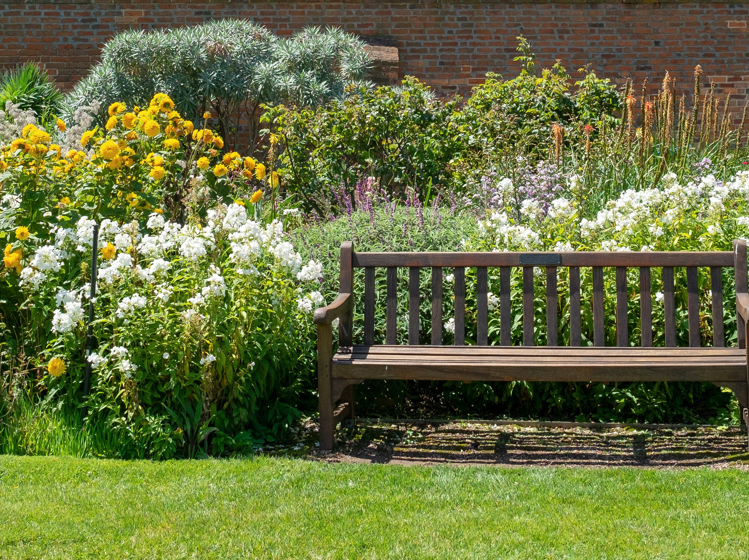
Notes:
Guided Imagery script

Slide 5
Wellness Tip of the Week: Guided Imagery
Guided Imagery
  Invoke positive sensory experiences
  Create the most realistic representation
  Train to conjure state of relaxation under stress
  Start with our breath
  Find a calm place in your mind (smell, visual, sound, touch)
  Make it personal to you *Preparation exercise*
  Let’s practice…

Slide 6


Self Reflection: Growth Mindset
What is a growth mindset?
Using our challenges, failures, and areas in need of support as learning opportunities to help us grow.
How can we foster a growth mindset?
Use shortfalls as learning opportunities.
Craft your grad school toolbox with the tools and resources to help foster growth.
  -Tutoring
-iLEARN
-Student Success Advisor
-Writing Center
-Faculty Advisor
-Course Faculty
-Career Center
-Campus policies and deadlines

Slide 7

Self Reflection: Resilience
What is resilience?
Resilience is defined as the “ability to recover from negative experiences and become stronger while overcoming them” (Ledesma, 2014, p.1).
How can I foster resilience?
Utilization of the “I have, I am, I can” Model (Grotberg, 2003).
-Helps to identify your strengths, struggles, passions, identities, and support in order to move through obstacles.
Don’t compare yourself to others.
  -You are on your own unique journey!
Practice self efficacy.
  -Recognize the barriers you experience, take ownership of your actions, and create an action plan to move forward (Ladesma, 2014, p.3).

Slide 8
Self Reflection Pathway
Self Reflection
Growth Mindset
Resilience

Slide 9

Self Reflection: Reflection Exercise
Let’s try practicing a self reflection exercise together!
-Be honest with yourself. The more honest you are in your self reflection, the more actionable items you can create for yourself moving forward.
-Be kind to yourself and give yourself grace.
-Be both constructive and supportive.

Slide 10
Reflection: Grotberg Exercise
1. What are things that you are?
2. What are things that you can do?
3. Who or what are things that you have to support you?

Slide 11

Self Reflection: Reflection Exercise Continued
Create A Self Reflection Routine
Know when to initiate self reflection
  Midterms/Finals
  When you fail to meet a goal or expectation you have set for yourself
  When you fail to meet a goal or expectation that someone has given you.
  At the end of every term
Utilize constructive feedback you have received in your reflection.
Do not just focus on what needs improvement.
  Identify your successes as well and how to maintain your strengths.

Slide 12

Self Reflection: Feedback
Feedback Is Important to Support Self Reflection.
Taking feedback as an opportunity for growth instead of an attack.
Giving yourself and others around you grace.
Don’t be afraid to ask for feedback!
Ensure you are in the right headspace to receive feedback.
Bringing people to the table for conversations instead of calling them out.
  -Praise in public. Tell people what they are doing right!
  -Removing emotional language in public feedback.

Slide 13
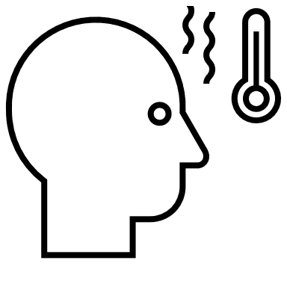
Self Reflection: Burnout & Motivation
What is burnout?
A state of exhaustion that involves “a sense of reduced accomplishment and loss of personal identity” (Mayo Clinic, 2021).
What can I do if I am feeling burnt out and unmotivated?
Remember your “why”!
  Remember what brought you to USAHS and your degree program.
  Don’t forget your hobbies.
Talk to a mentor in your field.
Volunteer.
Continue to practice self care.
Make an appointment with the Career Center.
  It is never to early to start items such as resume building and editing to ensure that when you apply for jobs, you are putting the best version of you on paper.
  Doing this can help you see the finish line.

Slide 14
Self Reflection: Burnout & Motivation
The Calendar Method
  Giving yourself incremental things to look forward to in order to stay motivated and avoid burnout.
    This helps to make the everyday not as monotonous!
  Small item every week: A walk, hike, coffee stop, watch your favorite show, unplug from social media, call a family member, gaming
  Medium item every month: Kayaking, meet up with friends, meet up with a mentor, go to your local library, create a piece of art, date night with your partner
  Large item every term: A concert, road trip, family trip, volunteer in your community

Slide 15
Reflection
1. What are YOUR signs of burnout?

Slide 16
Reflection
1. What motivates you?

Slide 17
Academic Support Information
Information about our Academic Support teams can be found on the MyUSA portal:
Academic Support
Sign up for course-specific group tutoring:
Tutoring
Find related presentations and more in our Innovation, Learning Excellence, and Academic Resource Network (iLEARN):
iLEARN
Visit the Student Wellness page for resources:
Student Wellness

Slide 18
References
Grotberg, E. H. (2003). Promoting resilience in displaced persons. Ahfad Journal,
20(1), 27-36. Retrieved February 20, 2019.
Ladesma, J. (2014). Conceptual frameworks and research models on resilience
in leadership. SAGE Open. 1-6. Retrieved February 22, 2019.
Mayo Clinic. (2021). Job Burnout: How to spot it and take action. Retrieved November 2, 2022, from https://www.mayoclinic.org/healthy-lifestyle/adult-health/in-depth/burnout/art-20046642#:~:text=Job%20burnout%20is%20a%20special,as%20depression%2C%20are%20behind%20burnout.

Slide 19

Q&A
Questions?

